Slide 1
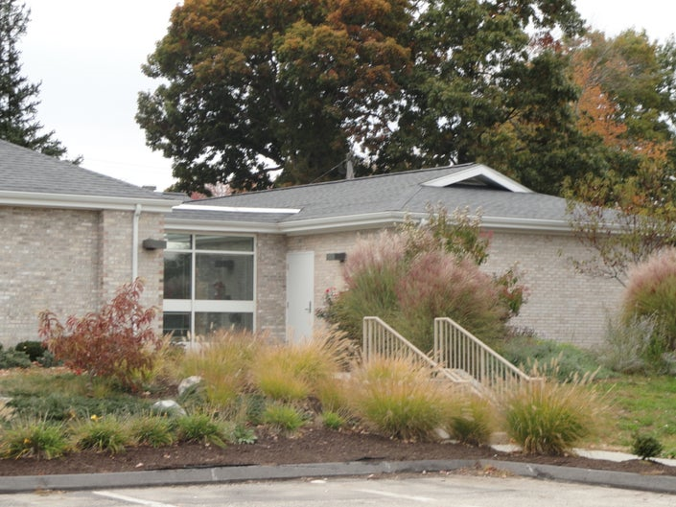
Human Services Replacement
Funding Request

Slide 2
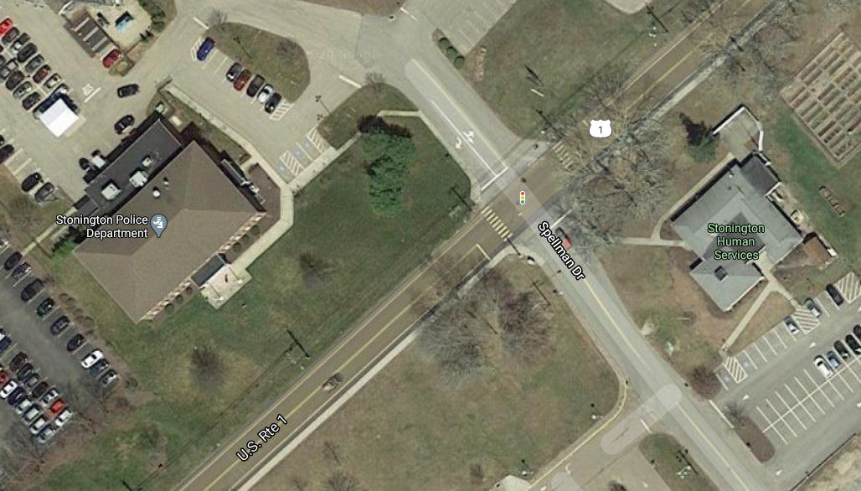
Police Station Human Services
Built 1976 for Police
New Police Facility 2000
Renovated 2001
Building Area: 5,102 sq ft
Existing Roof:
Combination membrane and asphalt shingle roof
Human Services:
Nine Employees
Divisions:
Social Services
Senior Services
Youth and Family Services
Recreation

Slide 3
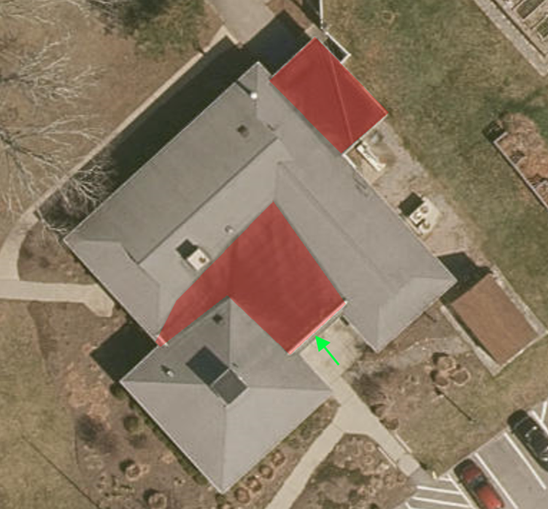
Project Scope
REPLACEMENT OF
4770 Sq Ft 20 year Asphalt Shingle
1,340 sq ft 30 year EPDM Flat Roofing
460 linear ft aluminum gutter and downspout

Slide 4
Options
Do Nothing: This will result in continued increase of costly repairs and deterioration of the building.
Fund as part of 2021/22 CIP: This will delay construction start to September 2021.

Slide 5
Recommendation
Transfer funding to design and construct Human Services Roof Replacement Project in the amount of $116,260 for completion in Spring 2021.

