Slide 1
Public Information Meeting Town of Stonington, CT February 11th, 2021
Pawcatuck Sidewalk Improvements

Slide 2
Using Webex
To ask a question, use this button
To access video functions and settings,
use this button
To access audio functions and settings,
use this button

Slide 3
Using Webex - Chat
To ask a question, use this button
Select who to send the message to
Type your question here
Please send your Name and
phone number/email address

Slide 4
Project Team
Steven Fraysier, PE
Dominic Celtruda, PLA
Mike Fisher, PE
Dr. Susan Cullen, AICP, PhD
PROJECT MANAGER
LANDSCAPE ARCHITECT
ENGINEER OF RECORD
DIRECTOR OF ECONOMIC & COMMUNITY DEVELOPMENT
Pawcatuck Sidewalk Improvements

Slide 5
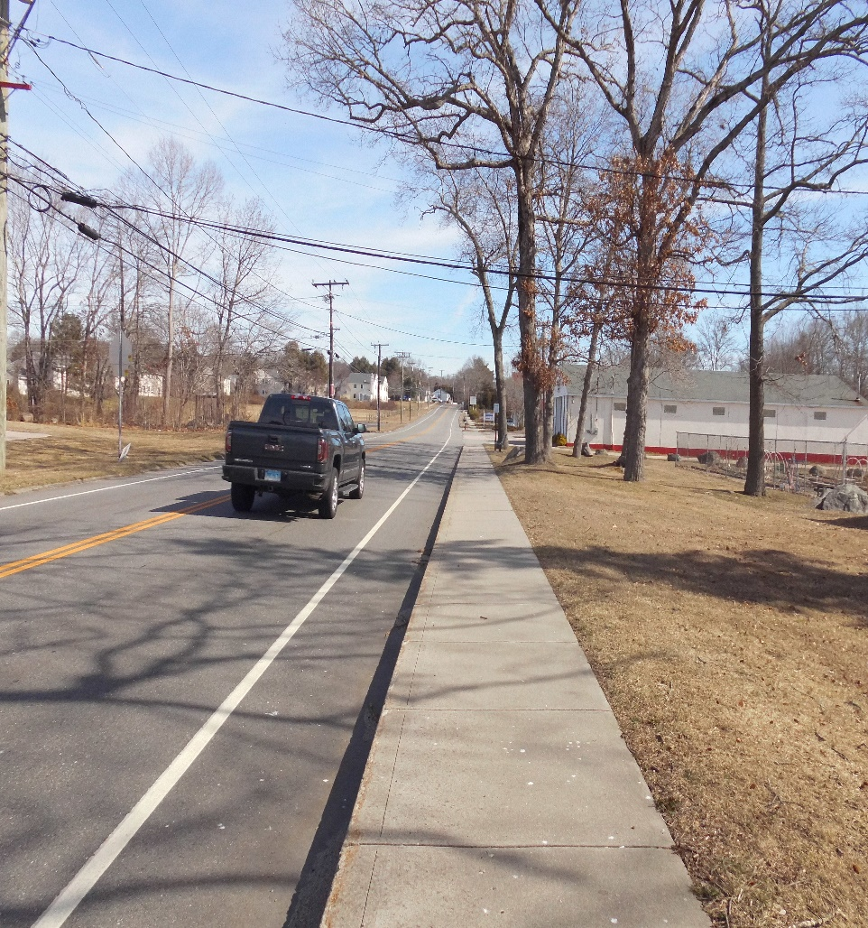
Meeting Agenda
Project Limits
Purpose and Need
Existing Conditions
Proposed Improvements
Open Comment Period
Pawcatuck Sidewalk Improvements

Slide 6
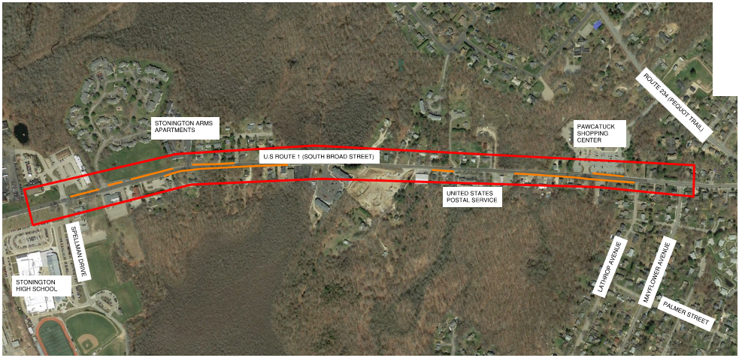
Project Location Map
LIMIT OF CONSTRUCTION
LIMIT OF CONSTRUCTION
N
Birchwood Drive
ROUTE 234 (PEQUOT TRAIL)
STONINGTON ARMS APARTMENTS
PAWCATUCK SHOPPING CENTER
U.S. ROUTE 1 (SOUTH BROAD STREET)
UNITED STATES POSTAL SERVICE
SPELLMAN DRIVE
LATHROP AVENUE
MAYFLOWER AVENUE
STONINGTON HIGH SCHOOL
PROPOSED SIDEWALK
PALMER STREET
PROJECT AREA
Pawcatuck Sidewalk Improvements

Slide 7
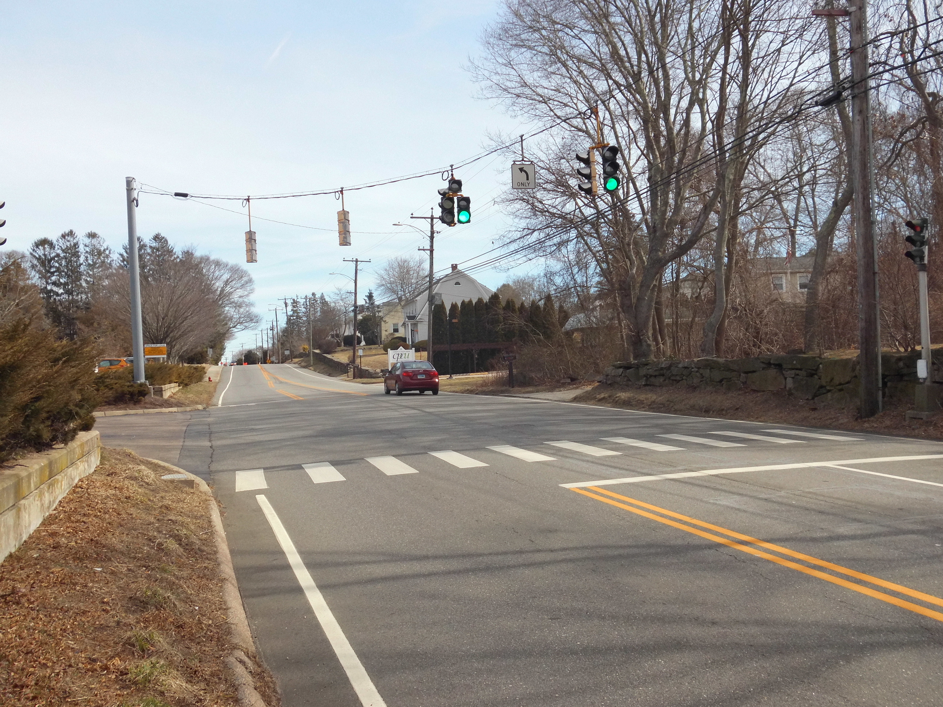
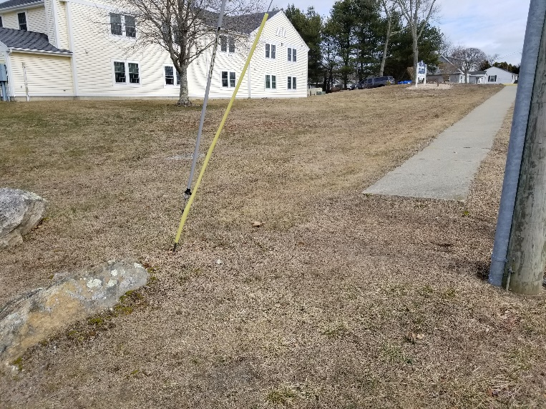
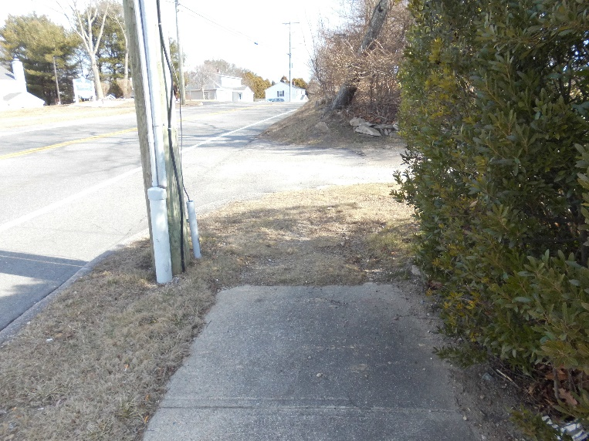
Purpose and Need
Safety
Primary: improve pedestrian safety
Corridor Connectivity
Install sidewalks in areas where sidewalks are missing
Pawcatuck Sidewalk Improvements

Slide 8
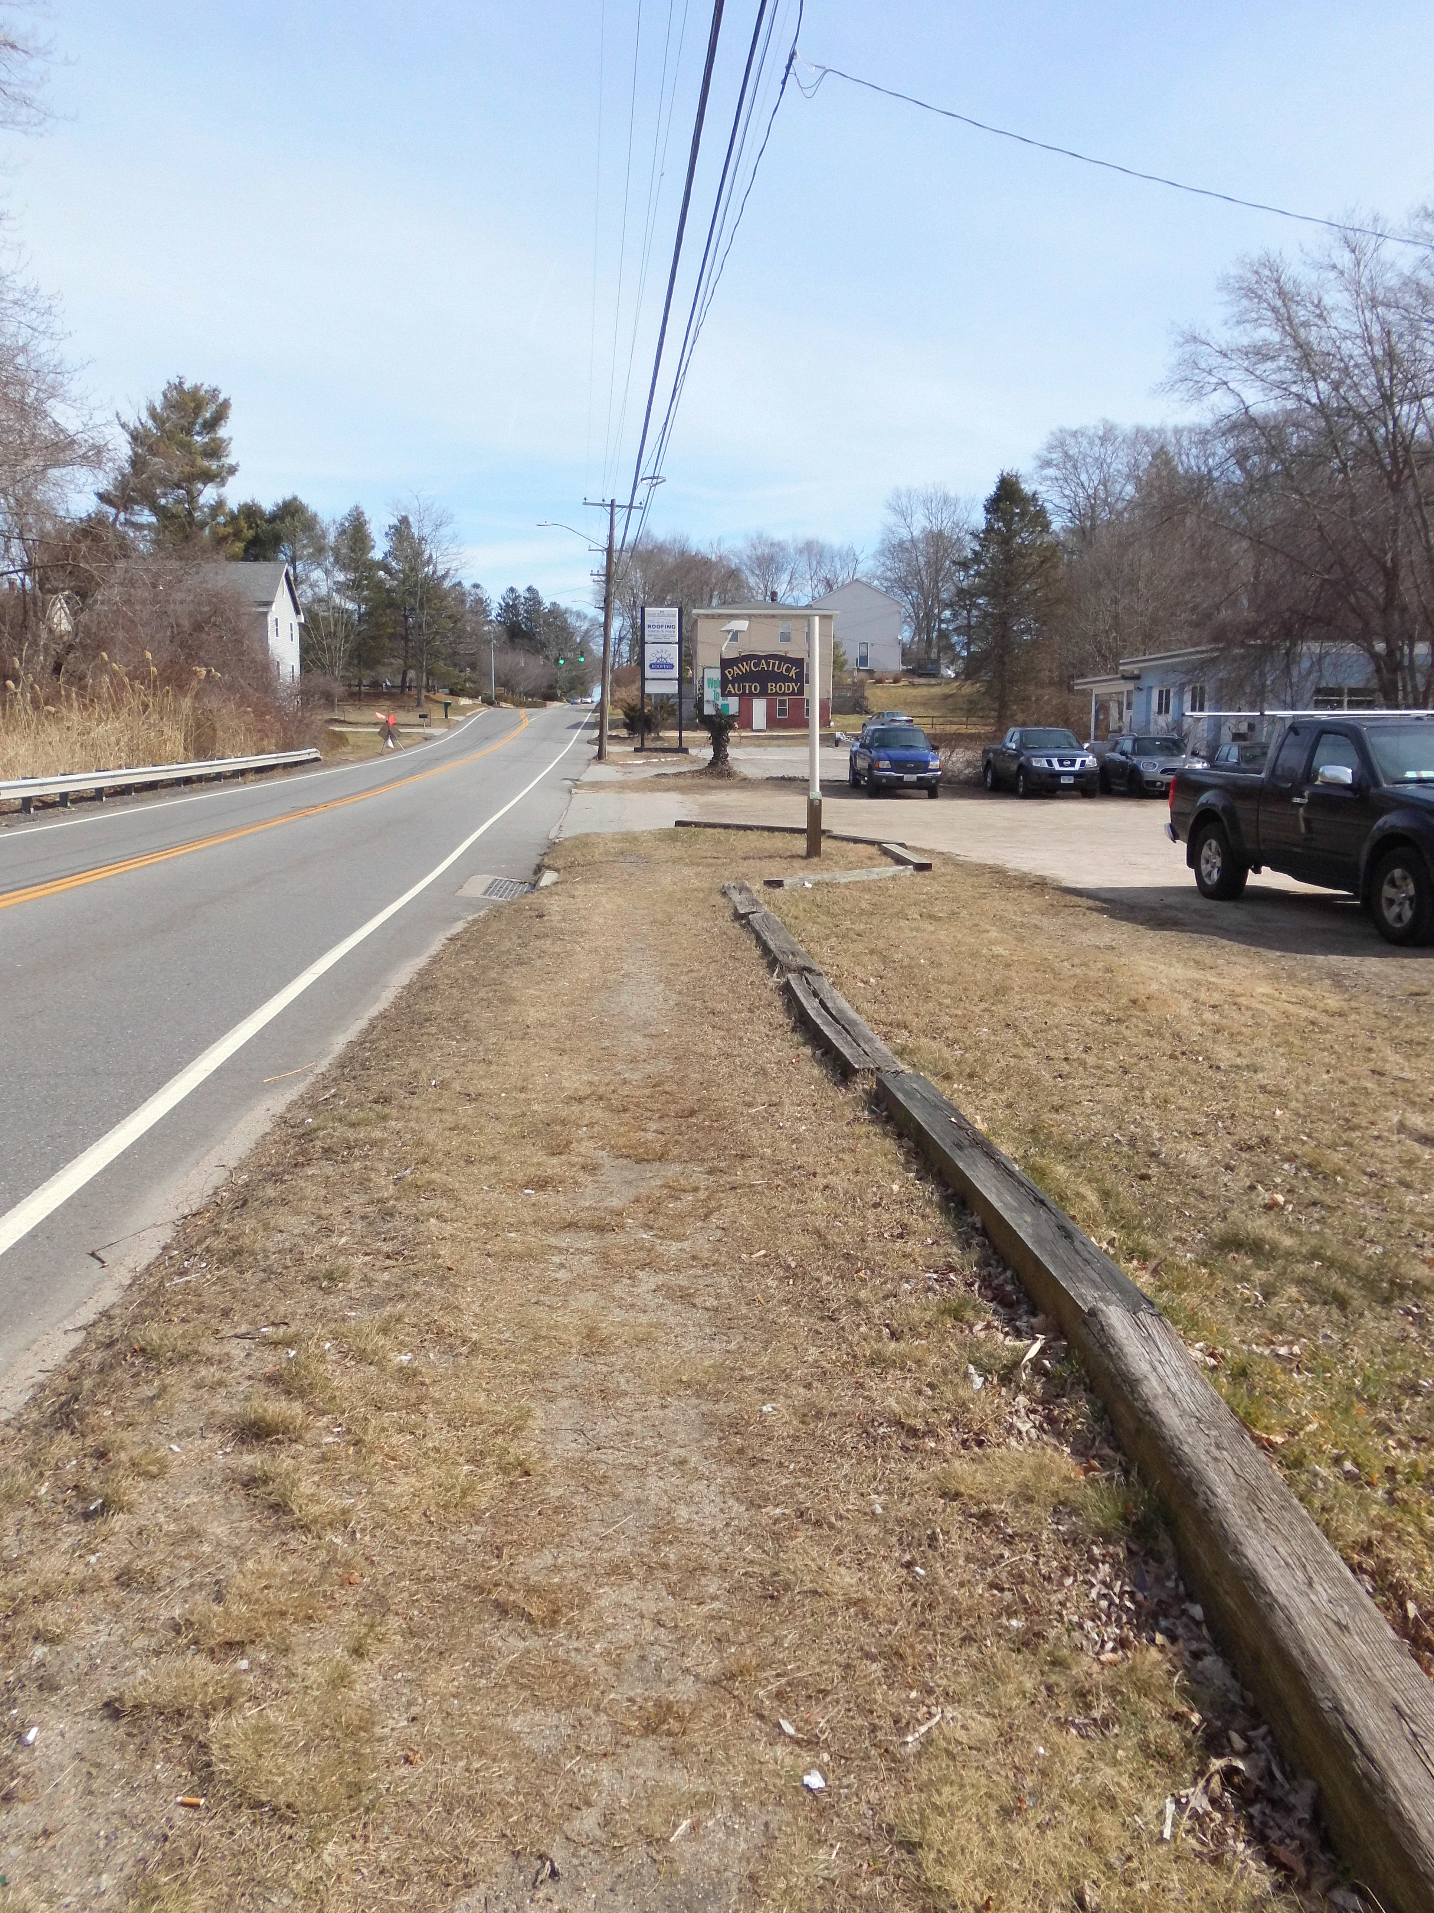
Existing Conditions
Project Limits
U.S. Route 1 between Spellman Drive and Mayflower Avenue
Total Length: 4800’+/-
Land Use: Mixed Residential & Commercial
Existing Concrete Sidewalk
Intermittent
Width: 4’-5’+/-
Approx. 0’-5’+/- from edge of roadway
Utilities
Overhead electric and communication/cable wires along the north and south sides of U.S. Route 1
Underground gas & water
Pawcatuck Sidewalk Improvements
Pawcatuck Sidewalk Improvements

Slide 9
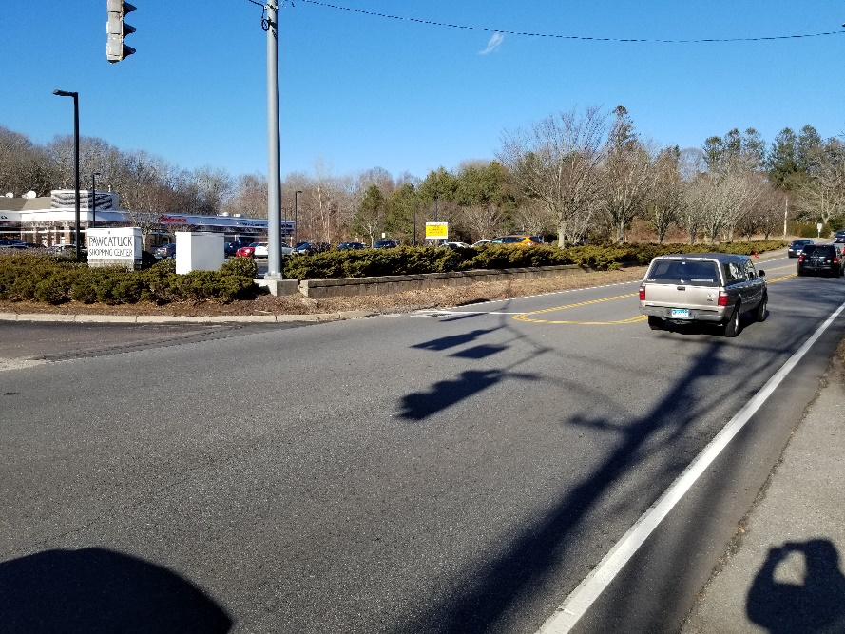
Proposed Improvements
New sidewalks
5’ wide concrete with grass shelf
5’ wide monolithic concrete sidewalk & curb
Driveway reconstruction
Pedestrian push-button relocation
Limited drainage Improvements
Curbing
Pavement Markings
11-foot lanes (instead of 12-foot)
bike pavement markings
Pawcatuck Sidewalk Improvements

Slide 10
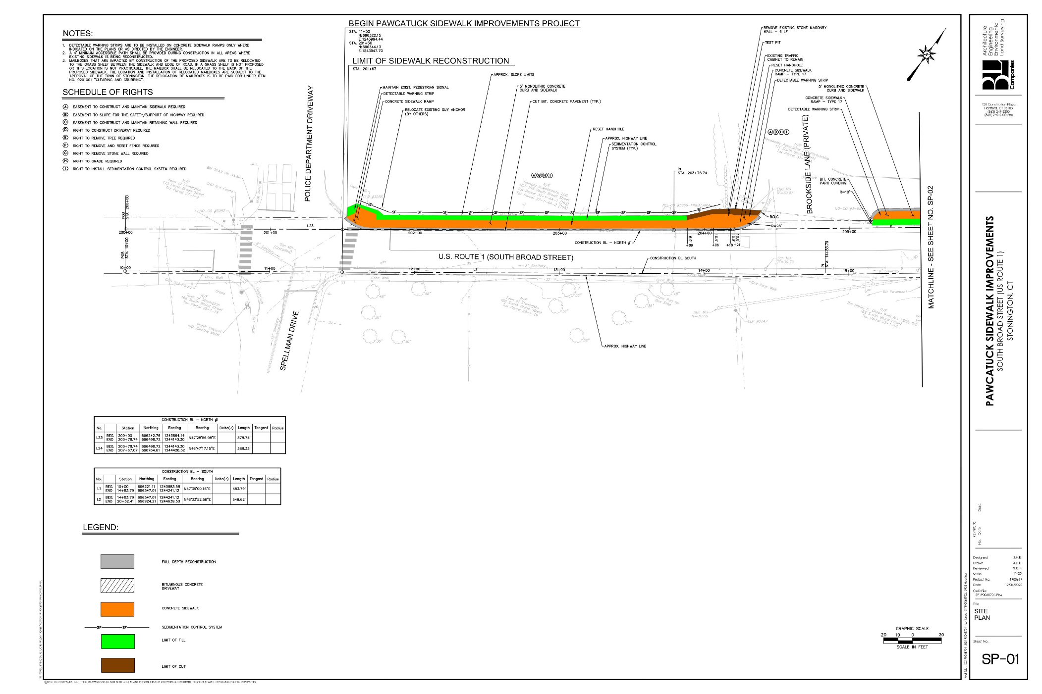
PROPERTY IMPACTS
NAME | ADDRESS | TYPE
DAMATO INVESTMENTS, LLC | 163-165 SOUTH BROAD STRTEET | EASEMENT TO CONSTRUCT AND MAINTAIN SIDEWALK
BROOKSIDE ASSOCIATES LTD PARTNERSHIP | 111 SOUTH BROAD STREET | EASEMENT TO CONSTRUCT AND MAINTAIN SIDEWALK
Pawcatuck Sidewalk Improvements

Slide 11
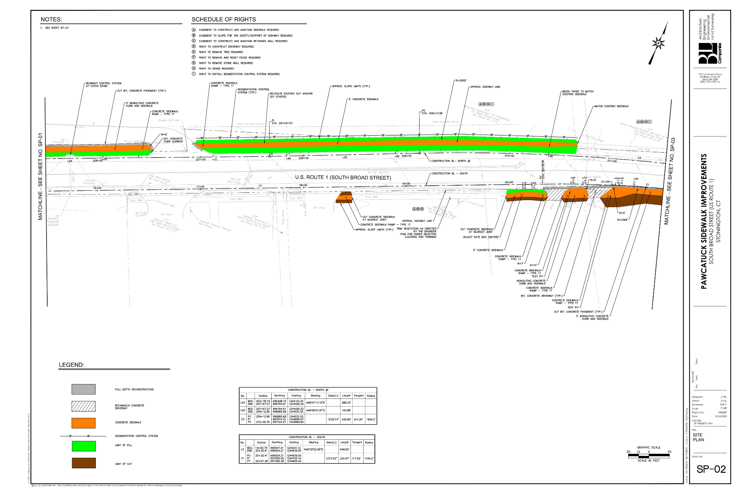
Stonington Arms Apts.
formerly Levant Cafe
PROPERTY IMPACTS
NAME | ADDRESS | TYPE
BROOKSIDE ASSOCIATES LTD PARTNERSHIP | 111 SOUTH BROAD STREET | EASEMENT TO CONSTRUCT AND MAINTAIN SIDEWALK
SENIOR CITIZENS HOUSING DEVELOPMENT CORP OF STONINGTON | 133 SOUTH BROAD STREET | EASEMENT TO CONSTRUCT AND MAINTAIN SIDEWALK
GBD REALTY, LLC | 148 SOUTH BROAD STREET | EASEMENT TO CONSTRUCT AND MAINTAIN SIDEWALK
BYRON M. STILLMAN | 138 SOUTH BROAD STREET | EASEMENT TO CONSTRUCT AND MAINTAIN SIDEWALK EASEMENT TO SLOPE FOR THE SAFETY OF THE HIGHWAY AND REMOVE, USE, OR RETAIN EXCAVATED MATERIAL
Pawcatuck Sidewalk Improvements

Slide 12
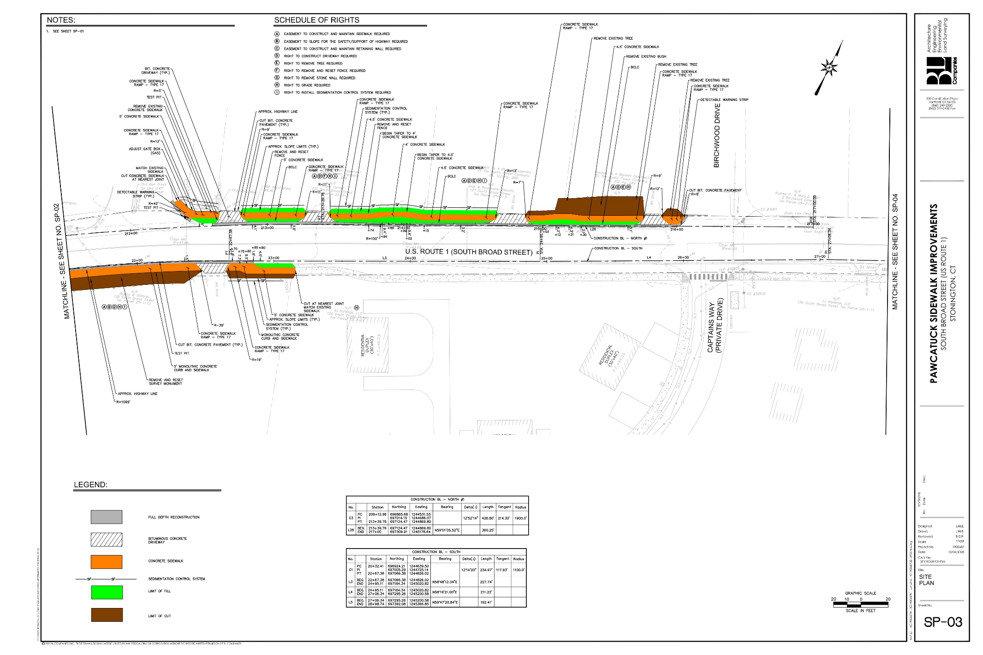
BYRON M. STILLMAN | 138 SOUTH BROAD STREET | EASEMENT TO CONSTRUCT AND MAINTAIN SIDEWALK EASEMENT TO SLOPE FOR THE SAFETY OF THE HIGHWAY AND REMOVE, USE, OR RETAIN EXCAVATED MATERIAL
PROPERTY IMPACTS
NAME | ADDRESS | TYPE
SENIOR CITIZENS HOUSING DEVELOPMENT CORP OF STONINGTON | 133 SOUTH BROAD STREET | EASEMENT TO CONSTRUCT AND MAINTAIN SIDEWALK
ADAM CORNELL | 131 SOUTH BROAD STREET | EASEMENT TO CONSTRUCT AND MAINTAIN SIDEWALK
JACK & ROSEMARIE DISCILLO | 127 SOUTH BROAD STREET | EASEMENT TO CONSTRUCT AND MAINTAIN SIDEWALK
JENNIFER A. CURTIN | 125 SOUTH BROAD STREET | EASEMENT TO CONSTRUCT AND MAINTAIN SIDEWALK
BYRON M. STILLMAN | 138 SOUTH BROAD STREET | EASEMENT TO CONSTRUCT AND MAINTAIN SIDEWALK EASEMENT TO SLOPE FOR THE SAFETY OF THE HIGHWAY AND REMOVE, USE, OR RETAIN EXCAVATED MATERIAL
Pawcatuck Sidewalk Improvements

Slide 13
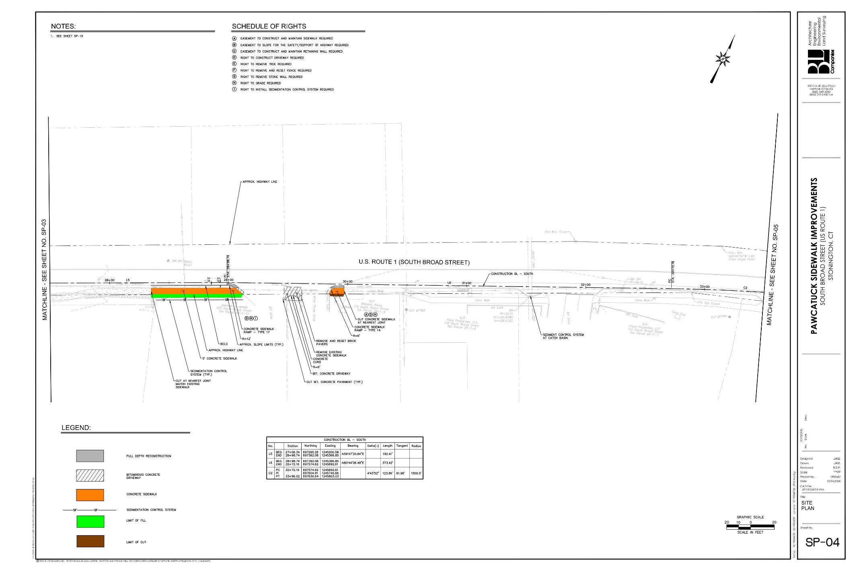
CT Behavioral Health Associates
Spruce Meadows
PROPERTY IMPACTS
NAME | ADDRESS | TYPE
BASSAM AWWA | 118 SOUTH BROAD STREET | EASEMENT TO CONSTRUCT AND MAINTAIN SIDEWALK
Pawcatuck Sidewalk Improvements

Slide 14
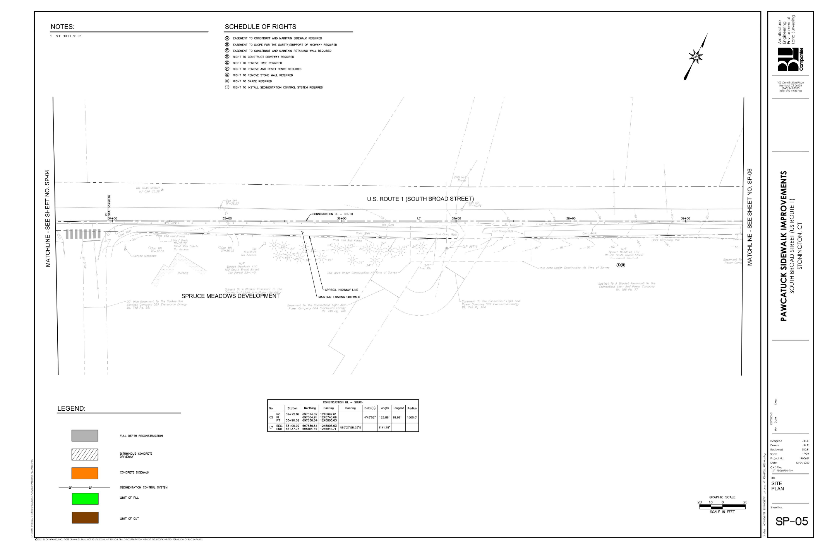
Pawcatuck Sidewalk Improvements

Slide 15
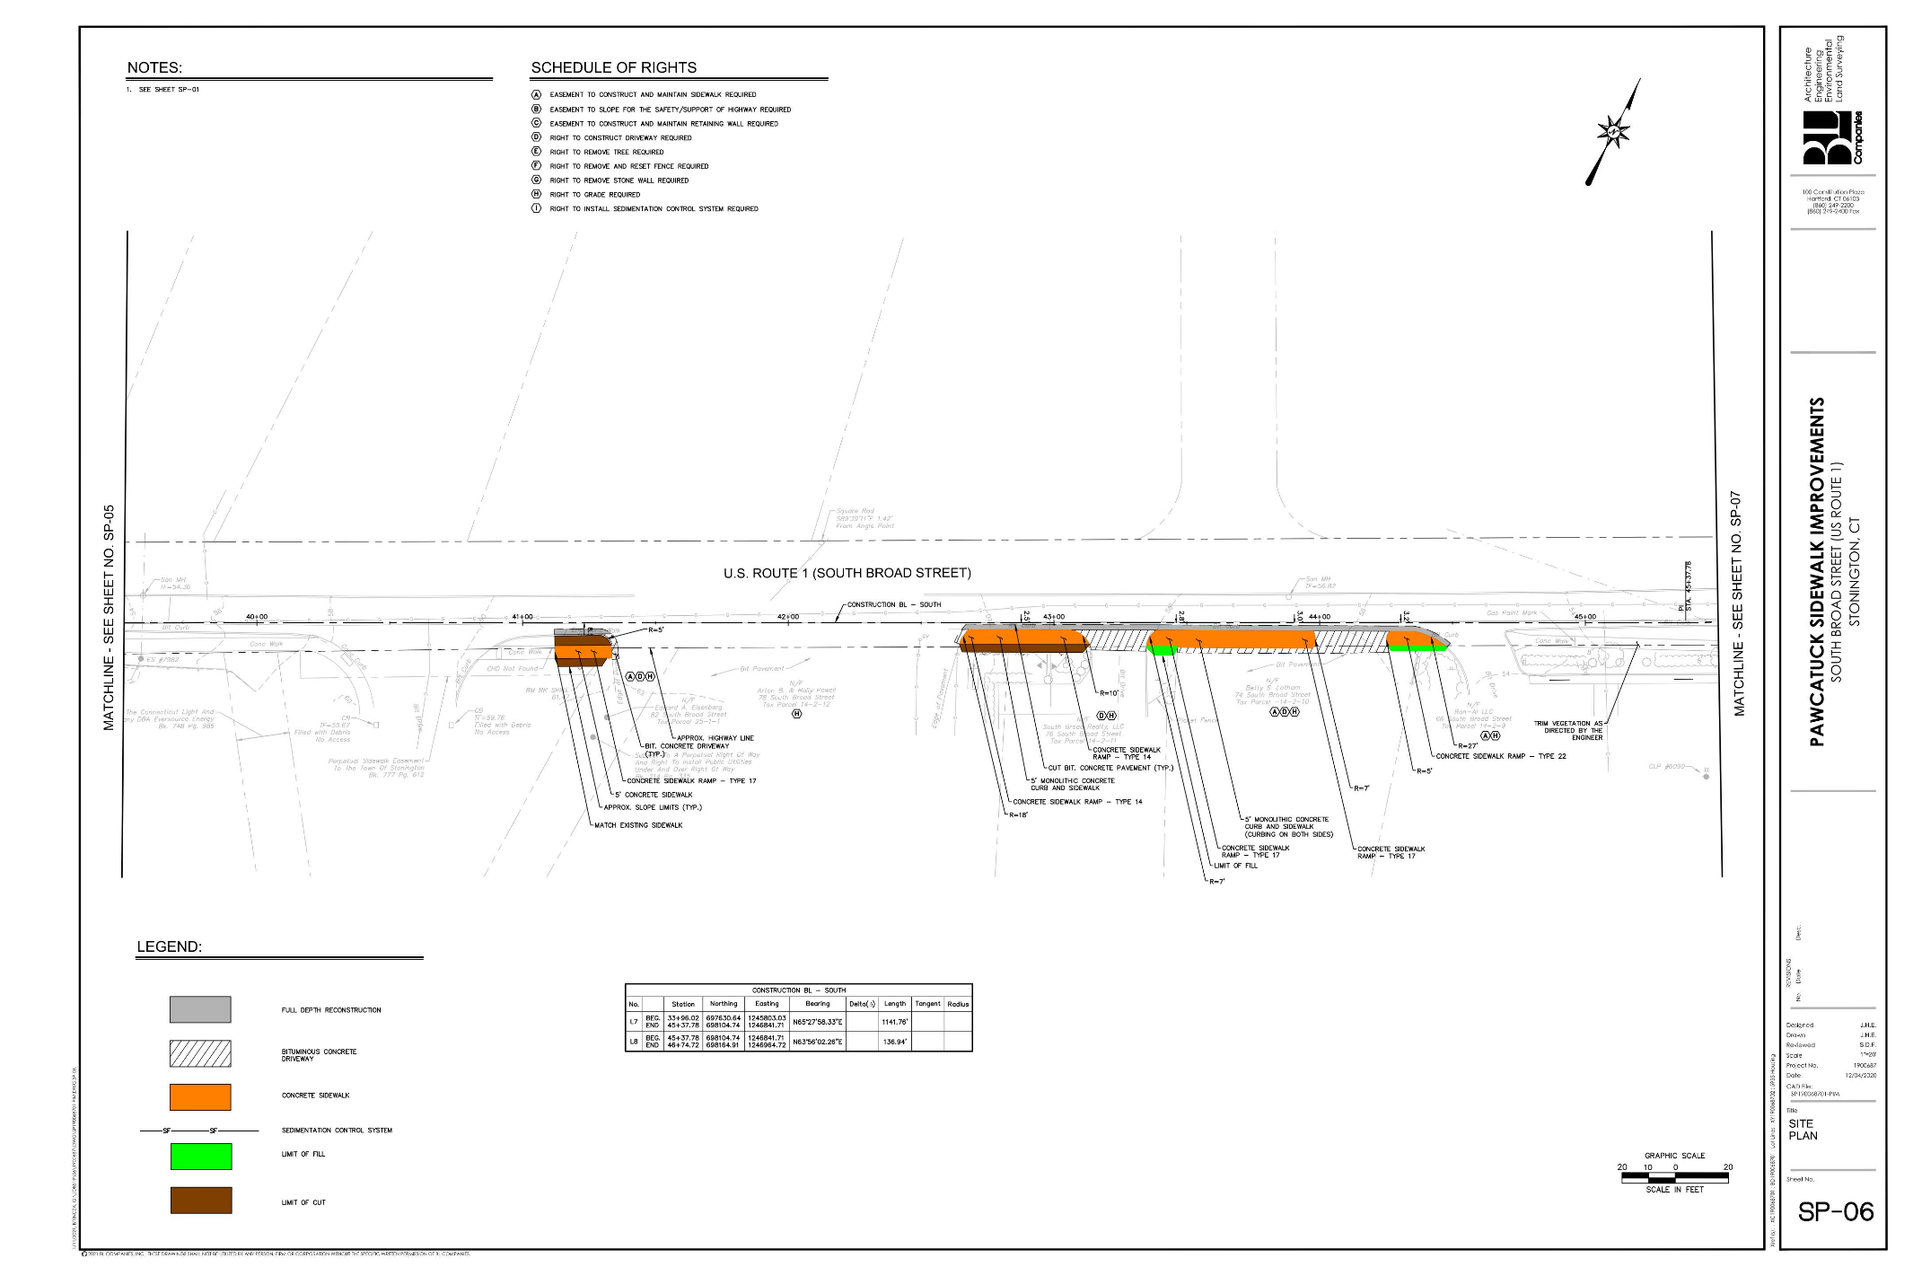
AB Powell
USPS
PROPERTY IMPACTS
NAME | ADDRESS | TYPE
EDWARD A. EISENBERG | 82 SOUTH BROAD STREET | EASEMENT TO CONSTRUCT AND MAINTAIN SIDEWALK
BETTY S. LATHAM | 74 SOUTH BROAD STREET | EASEMENT TO CONSTRUCT AND MAINTAIN SIDEWALK
RON-AI LLC | 66 SOUTH BROAD STREET | EASEMENT TO CONSTRUCT AND MAINTAIN SIDEWALK
Pawcatuck Sidewalk Improvements

Slide 16
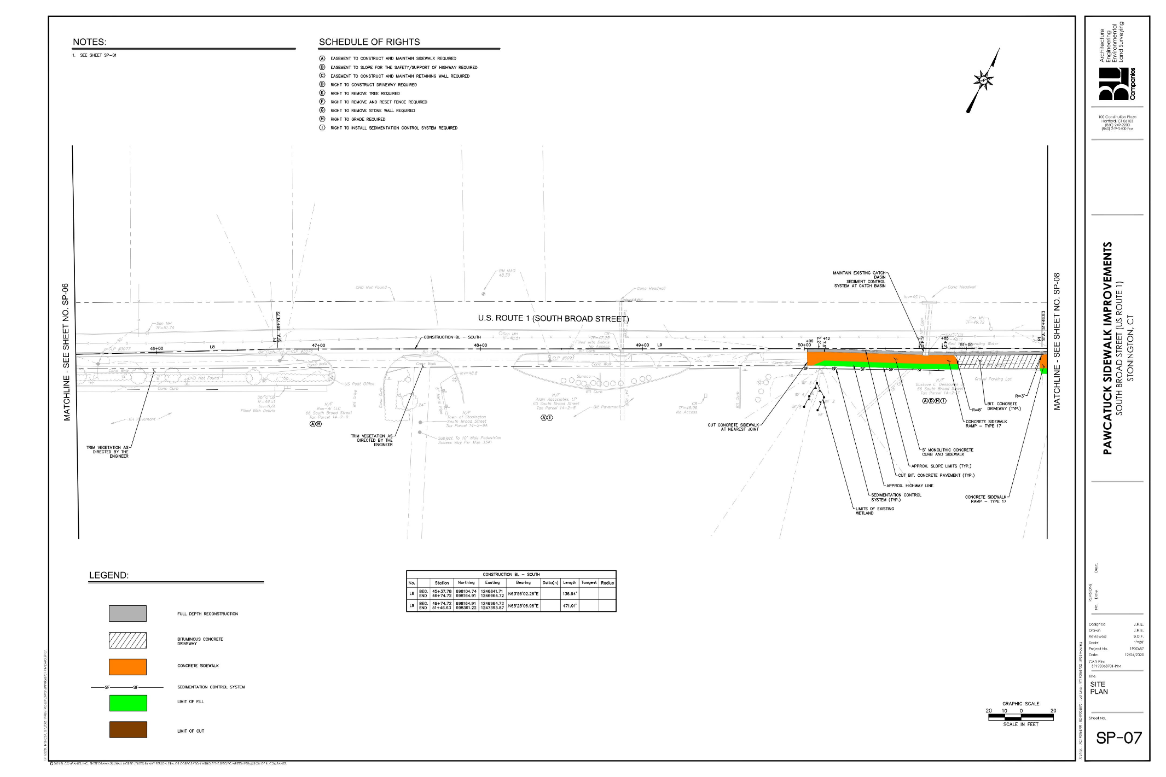
Sunoco
PROPERTY IMPACTS
NAME | ADDRESS | TYPE
ALDIN ASSOCIATES, LP | 60 SOUTH BROAD STREET | EASEMENT TO CONSTRUCT AND MAINTAIN SIDEWALK
GUSTAVE E. DESSAULES | 56 SOUTH BROAD STREET | EASEMENT TO CONSTRUCT AND MAINTAIN SIDEWALK
Pawcatuck Sidewalk Improvements

Slide 17
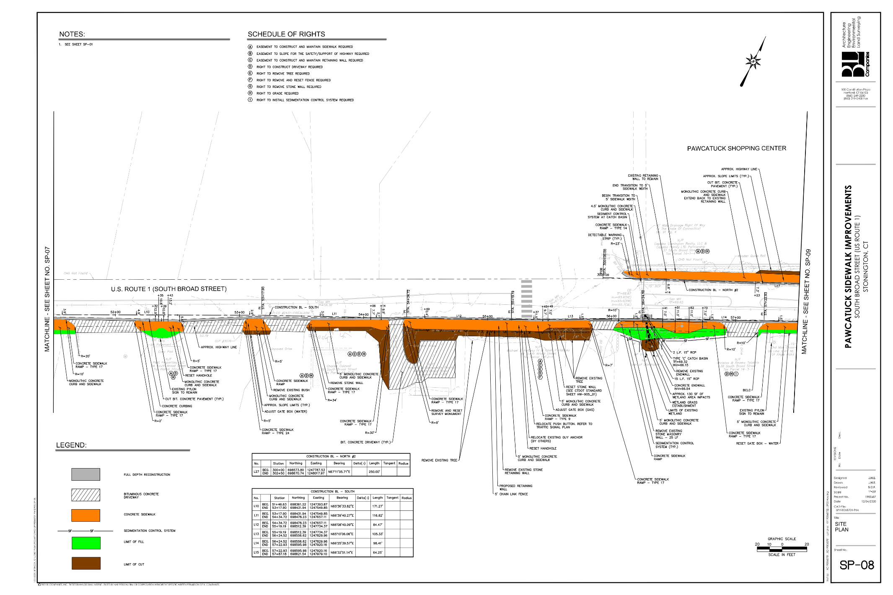
PROPERTY IMPACTS
NAME | ADDRESS | TYPE
GUSTAVE E. DESSAULES | 56 SOUTH BROAD STREET | EASEMENT TO CONSTRUCT AND MAINTAIN SIDEWALK
PMIG PROPERTIES, LLC | 45 SOUTH BROAD STREET | EASEMENT TO CONSTRUCT AND MAINTAIN SIDEWALK
CHARLES CALDWELL | 50 SOUTH BROAD STREET | EASEMENT TO CONSTRUCT AND MAINTAIN SIDEWALK
PETER J. & BERNADETTE PREVITY | 48 SOUTH BROAD STREET | EASEMENT TO CONSTRUCT AND MAINTAIN SIDEWALK AND RETAINING WALL EASEMENT TO SLOPE FOR THE SAFETY OF THE HIGHWAY AND REMOVE, USE, OR RETAIN EXCAVATED MATERIAL
MICHAEL J. HALLISEY IV & KEVIN P. HALLISEY | 44 SOUTH BROAD STREET | EASEMENT TO CONSTRUCT AND MAINTAIN SIDEWALK AND RETAINING WALL
CAPALBO STONINGTON REALTY, LLC & CAPALBO FAMILY LTD PARTNERSHIP | 37 SOUTH BROAD STREET | EASEMENT TO CONSTRUCT AND MAINTAIN SIDEWALK
Pawcatuck Sidewalk Improvements

Slide 18
PROPERTY IMPACTS
NAME | ADDRESS | TYPE
CAPALBO STONINGTON REALTY, LLC & CAPALBO FAMILY LTD PARTNERSHIP | 37 SOUTH BROAD STREET | EASEMENT TO CONSTRUCT AND MAINTAIN SIDEWALK
Pawcatuck Sidewalk Improvements

Slide 19
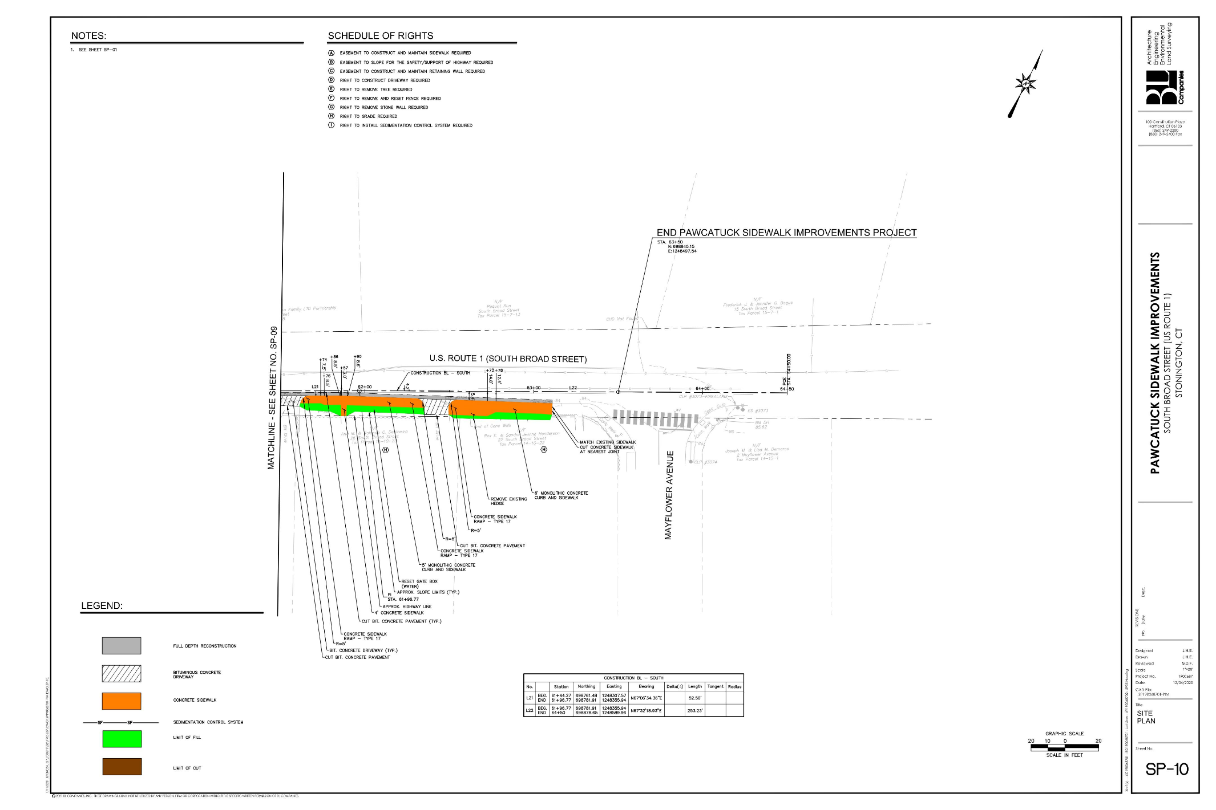
Pawcatuck Sidewalk Improvements

Slide 20
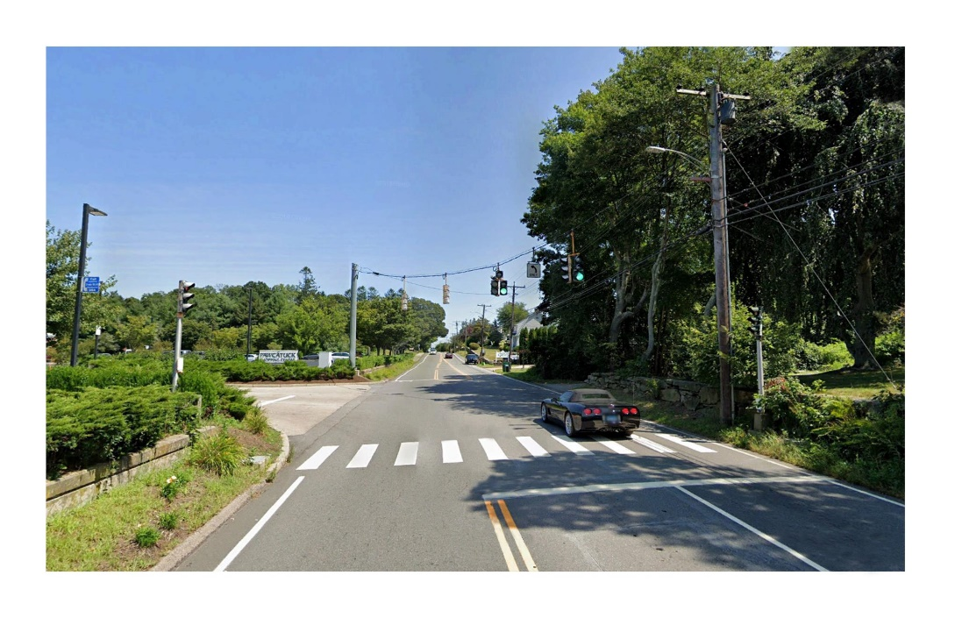
Project Rendering - Before

Slide 21
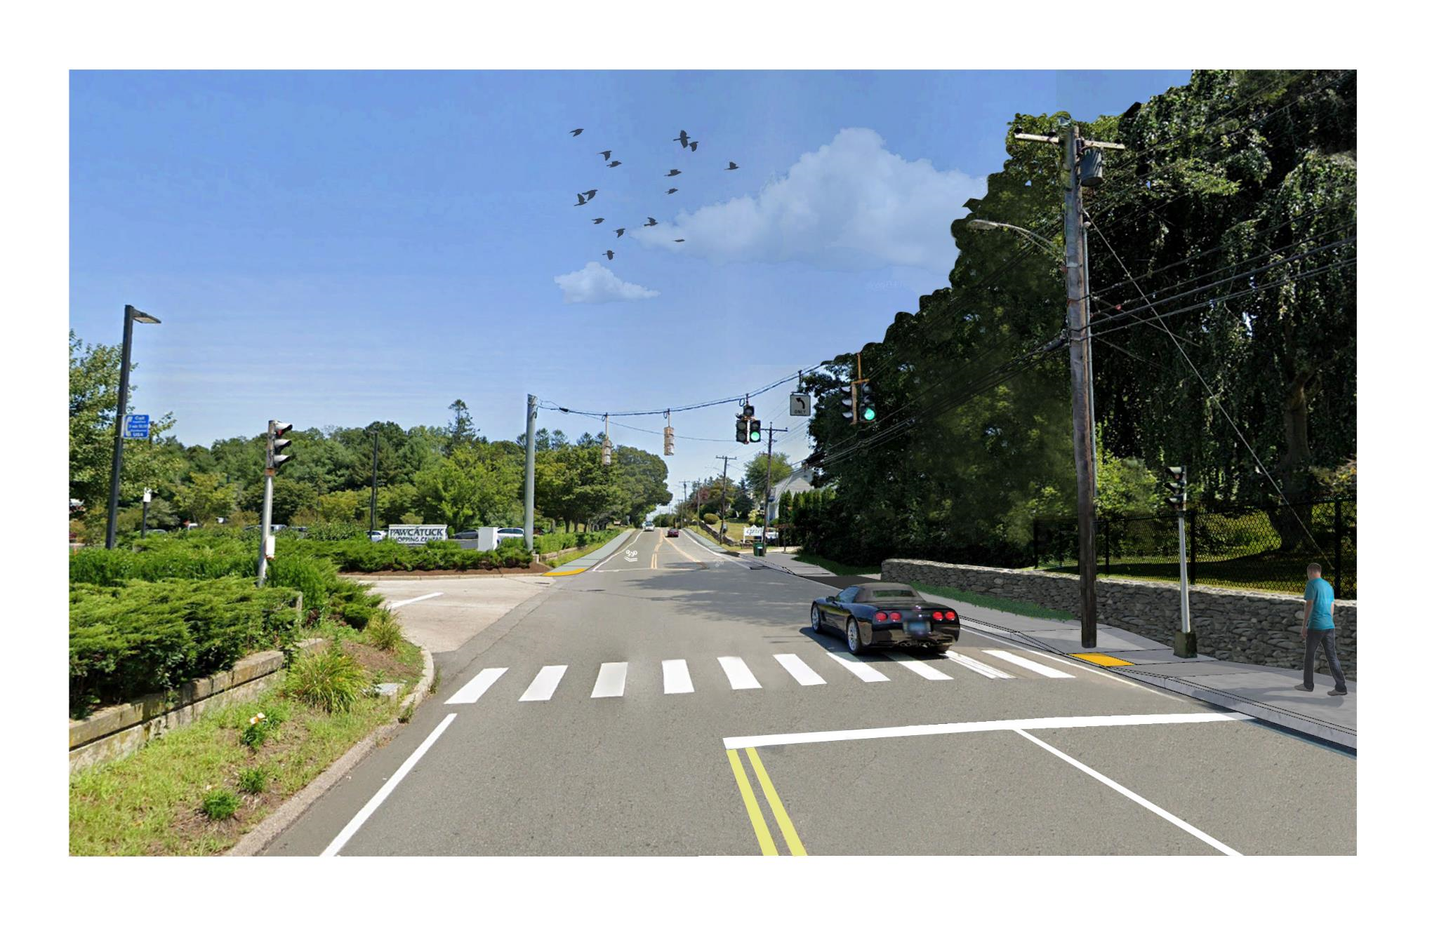
Project Rendering - After

Slide 22
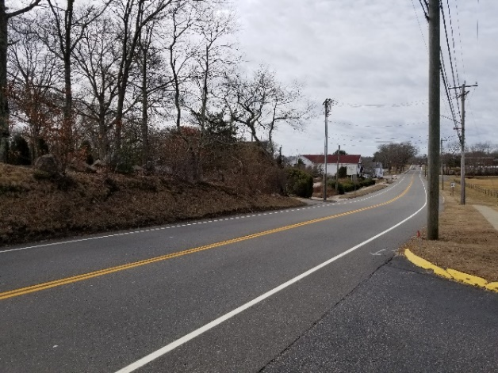
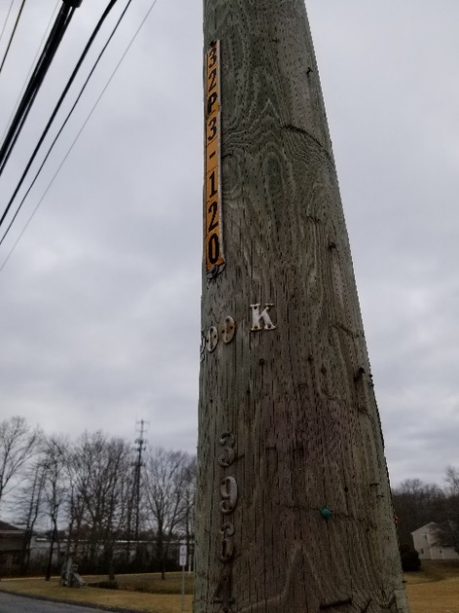
Utilities and Rights-of-Way
Property Impacts
Utility Impacts
Utility Guy Wire Relocations
Gas Main Relocation
Easements to Construct and Maintain Sidewalk
Easements to Construct and Maintain Retaining Wall
Rights to Grade
Rights to Construct Driveway
Rights to Install Sedimentation Control System
Rights to Remove Tree
Pawcatuck Sidewalk Improvements

Slide 23
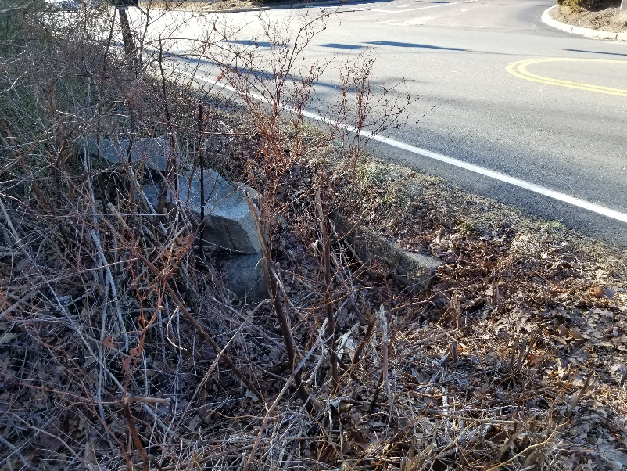
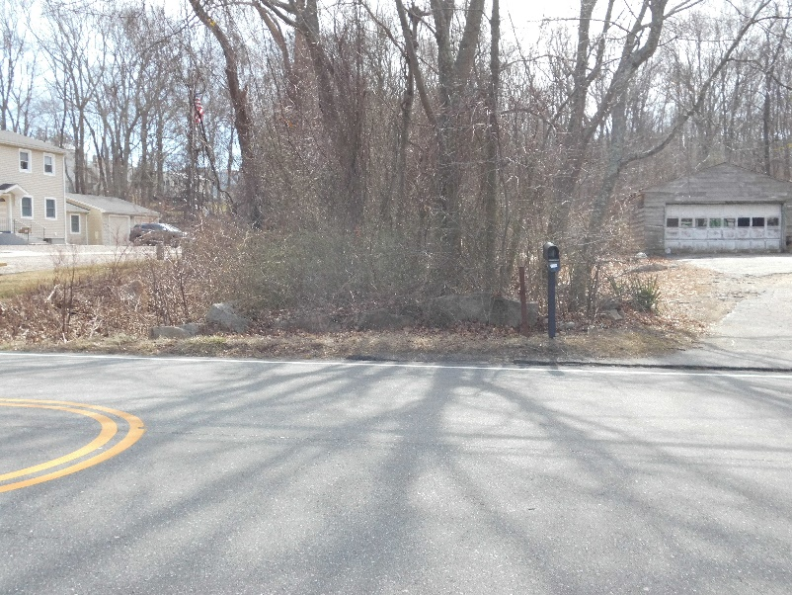
Permits Required
Local Inland Wetland Permit - Approved
Army Corps of Engineers Self Verification
CTDOT Encroachment Permit
Pawcatuck Sidewalk Improvements

Slide 24
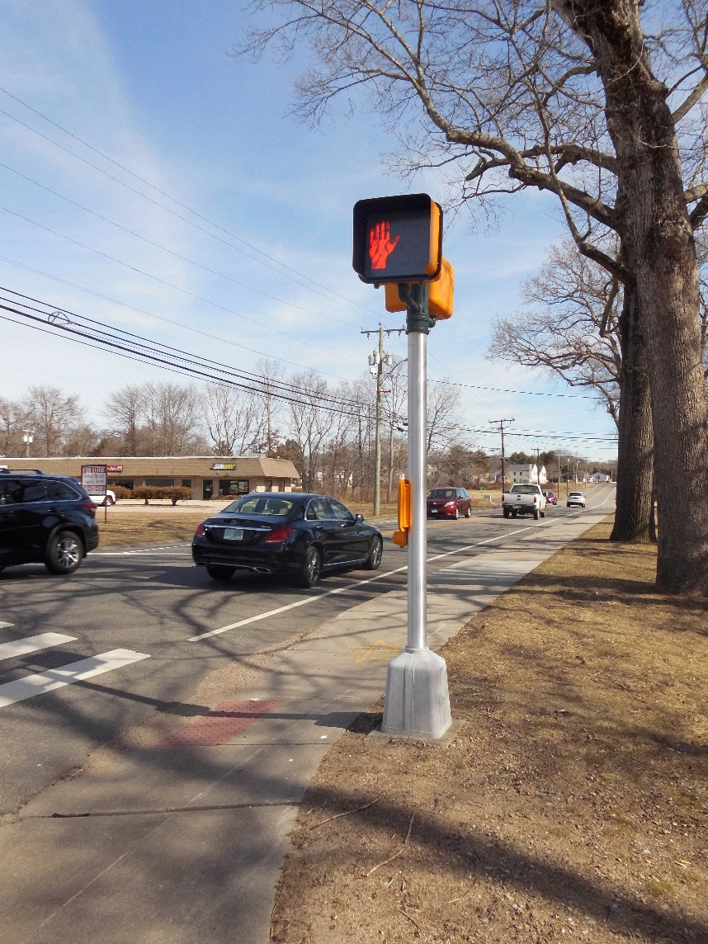
Project Financials and Schedule
Design to be Completed Spring 2021
Construction to Complete Fall of 2021
Estimated Costs: $950,000
Project Funding Sources:
Municipal Funds
Urban Act Grant - $600,000 committed
Pawcatuck Sidewalk Improvements
Notes:
Dominick

Slide 25
Public Information Meeting Town of Stonington, CT February 11th, 2021
Thank You!

Slide 26
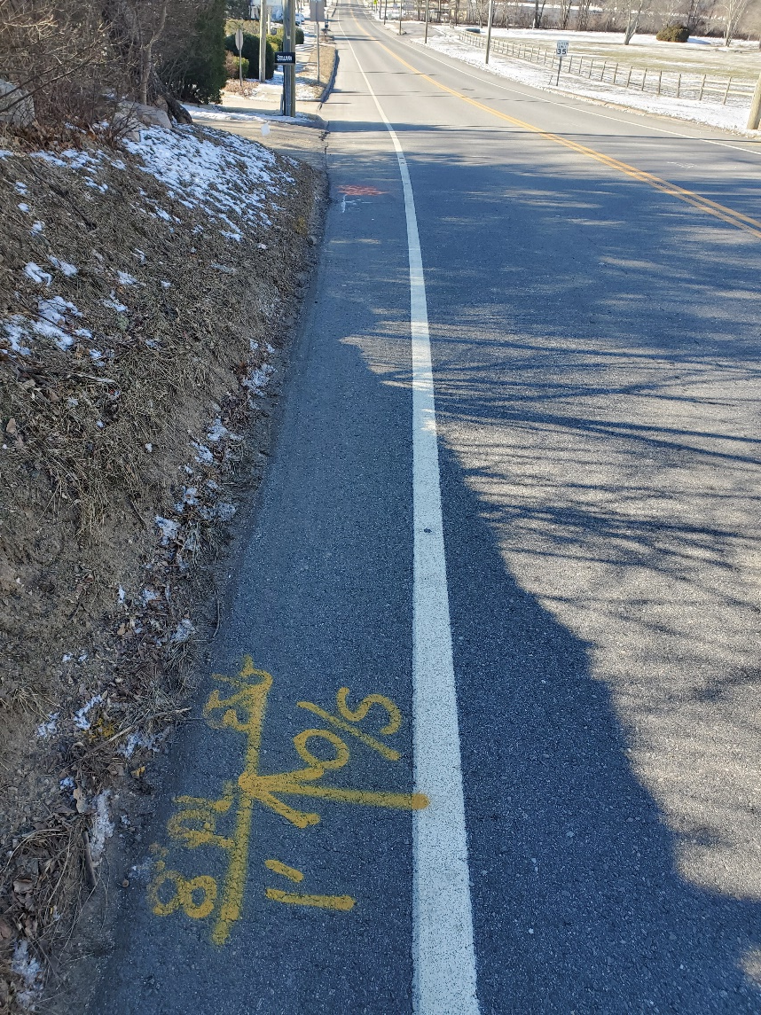
Frequently Asked Questions
How will I be notified of construction on my property?
Where will mailboxes be placed?
How will property access be maintained during construction?
Will construction debris/materials be cleaned up if a mess is made on my property?
What will happen to my lawn if it gets damaged by construction activities?
Pawcatuck Sidewalk Improvements
Notes:
Dominick

Slide 27
Comments
Please submit all comments to:
Dr. Susan Cullen, AICP, PhD
Director of Economic and Community Development
Town of Stonington
152 Elm Street
Stonington, Connecticut 06378
Email: scullen@stonington-ct.gov
Deadline for Comments: February 26, 2021
Pawcatuck Sidewalk Improvements

