Slide 1
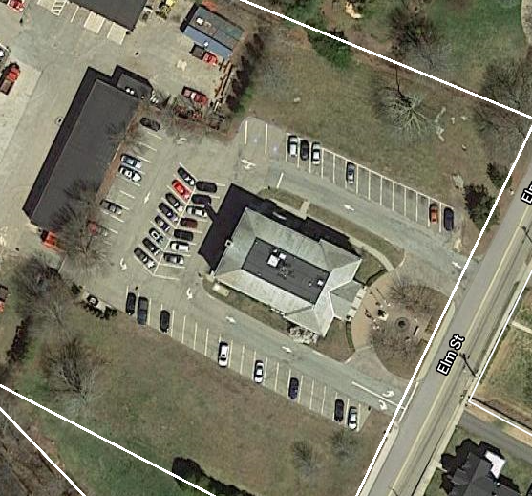
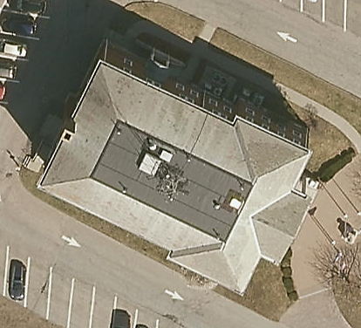
Town Hall Roof Replacement
Funding Request

Slide 2
Project Facts
Slate Roof | 5,303 sq ft | 93 yrs. old
Low Slope Rubber | 1,765 sq ft | 7 yrs. old
Office Space | 16,934 sq ft
Employees | 40
Departments | 17
Replacement Costs | $187,780

Slide 3
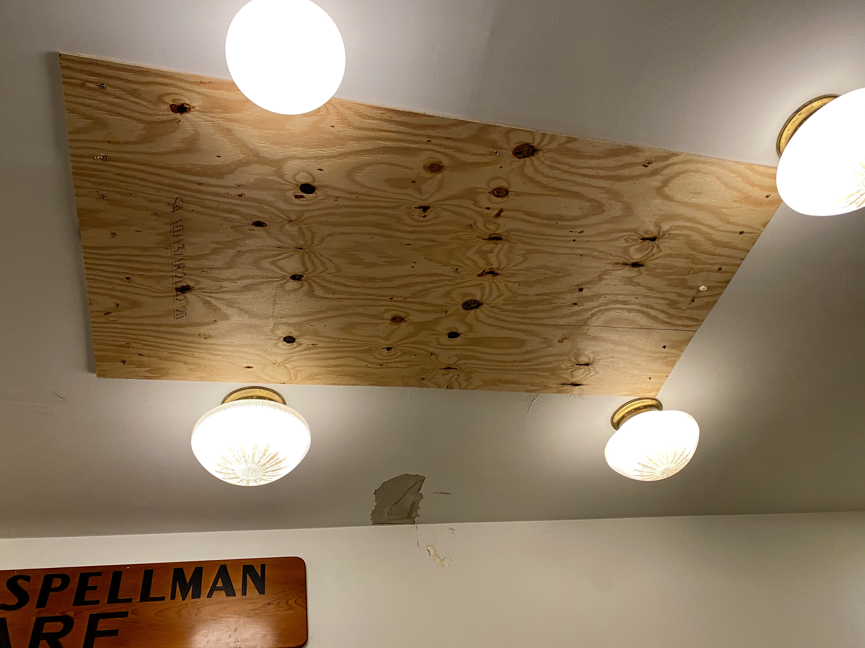
Leaking Inside Town Hall

Slide 4
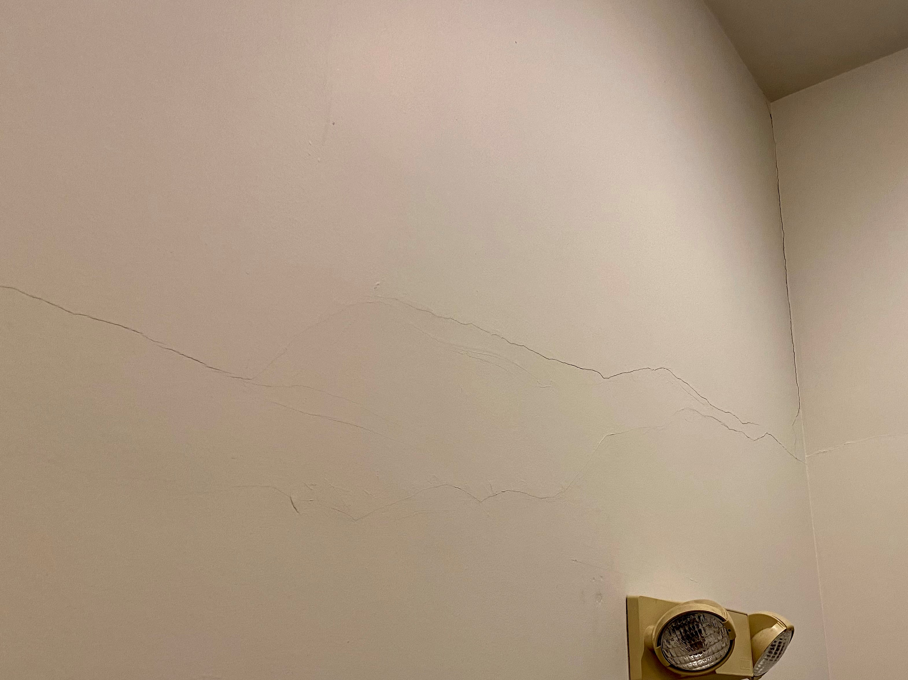
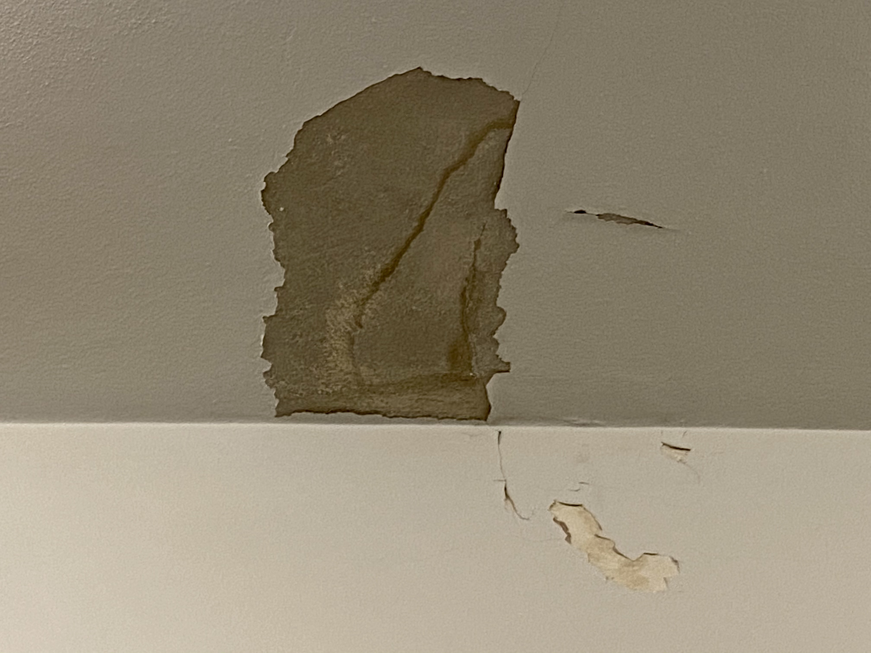

Slide 5
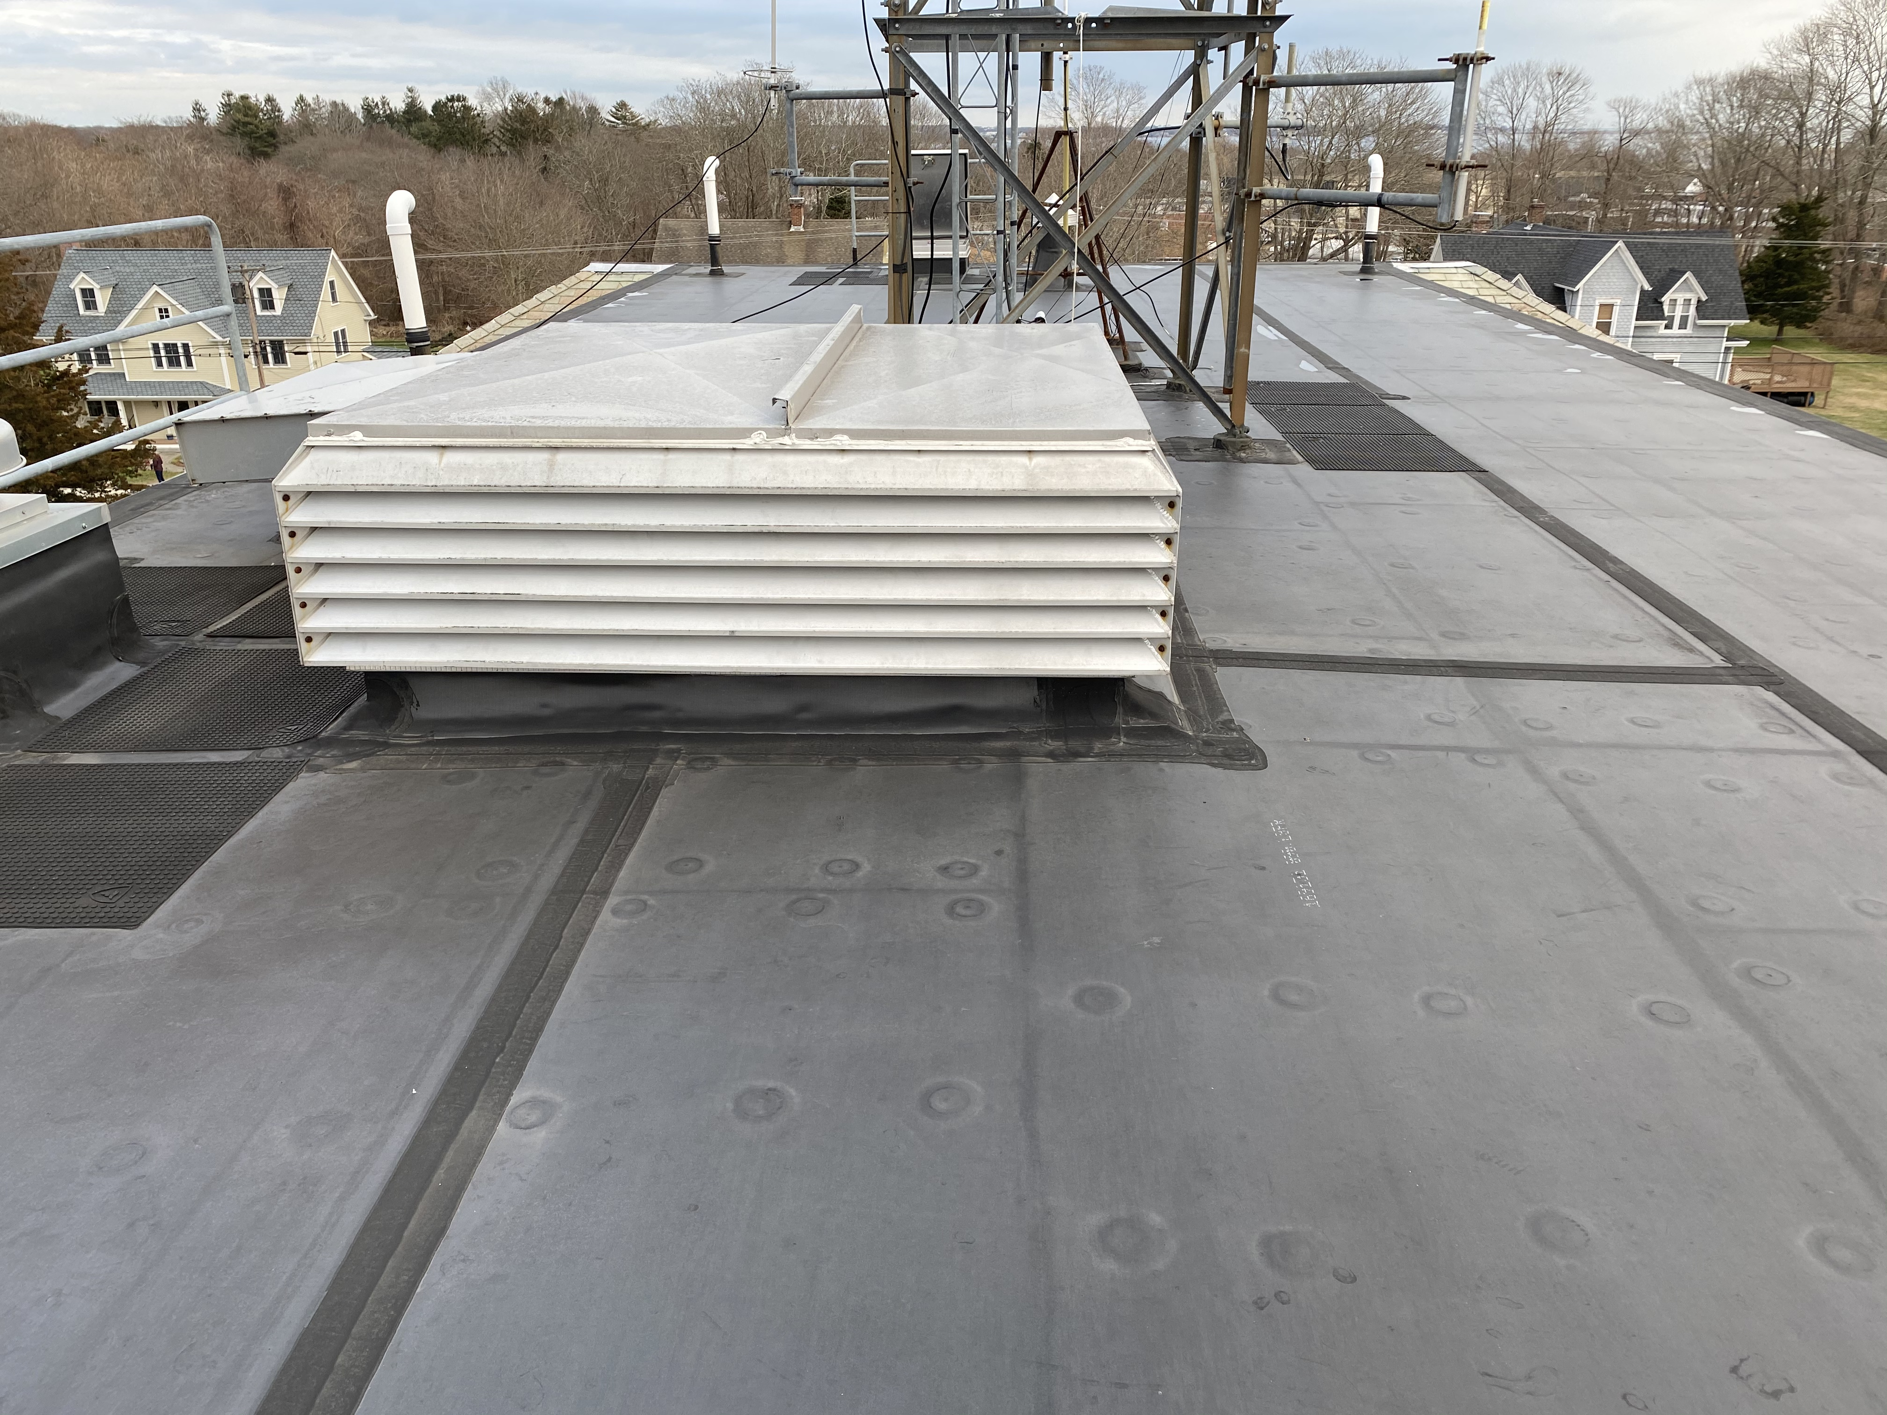
Low Slope Rubber Roof

Slide 6
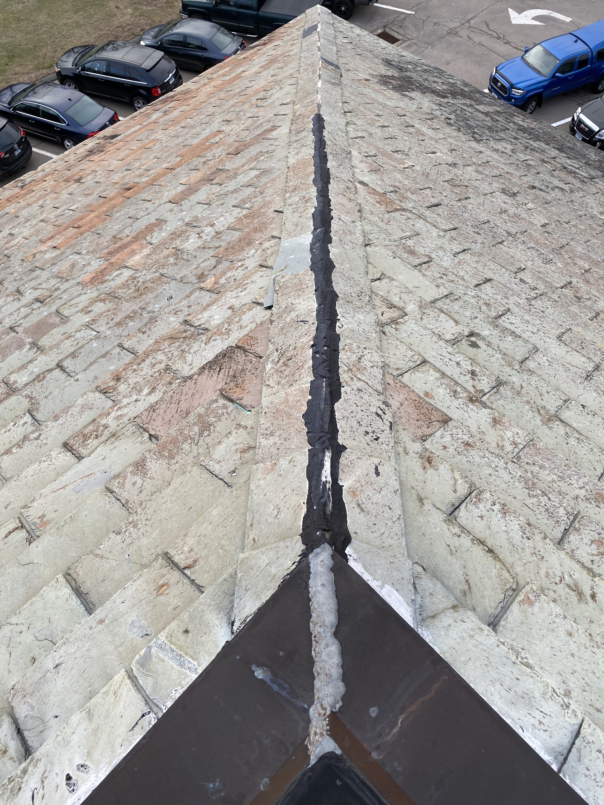

Slide 7
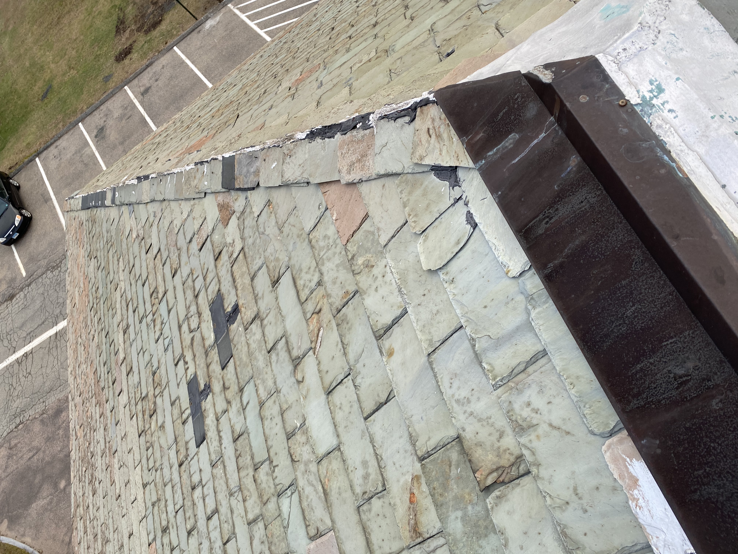
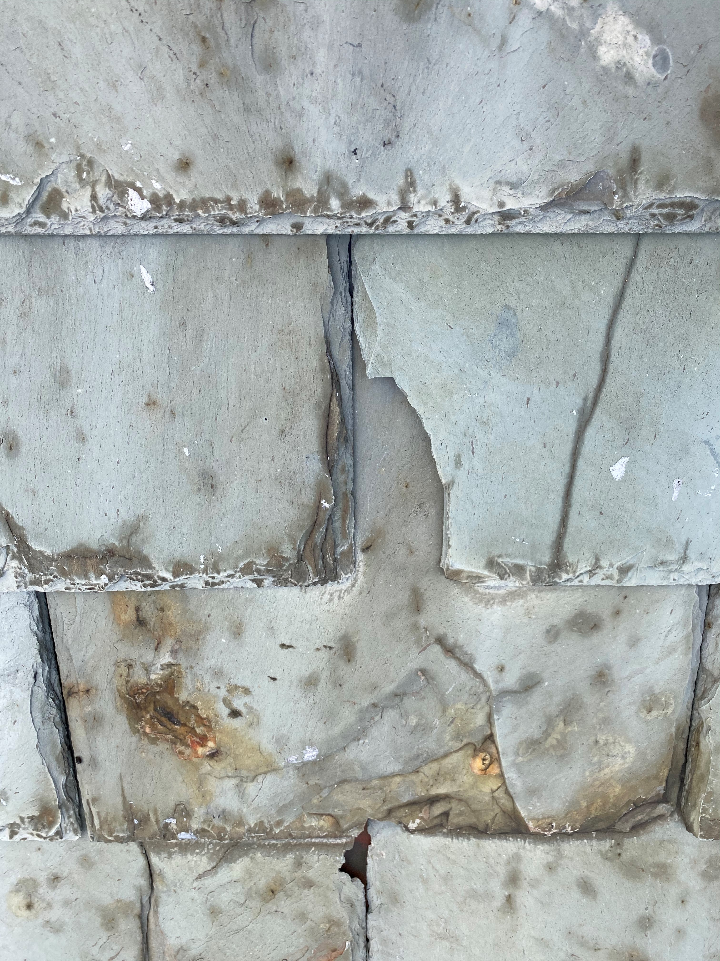

Slide 8
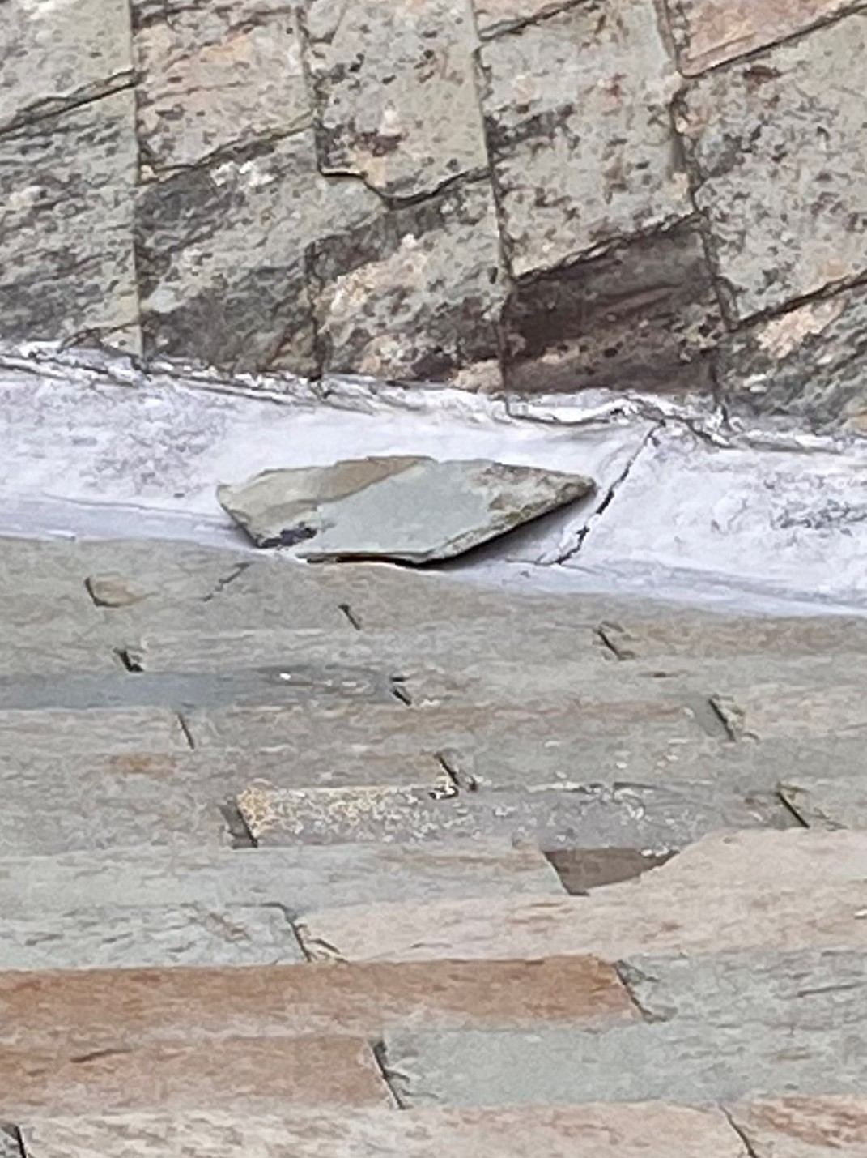
Project Scope
Replace approximately 5,303 sq. ft. of existing slate roof with new 20-year asphalt shingle
Installation of solid ½ inch plywood sheathing over the existing 1x6 battens
320 lin. ft. built-in copper gutter lining
200 lin. ft. aluminum downspouts
Replacement of deteriorated wood facia and cornice
Painting of facias, cornice and portico gable and ceiling
Masonry chimney restoration
ACM removal and disposal

Slide 9
Options
Do Nothing: This will result in continued increase of costly repairs and deterioration of the building.
Imitation Slate Roof Replacement: This will not provide as reliable warrantied system and increase the total project costs to $210,720.
Fund as part of 2021/22 CIP: This will delay construction start to September 2021.

Slide 10
Recommendation
Transfer funding to design and construct the Town Hall Roof Replacement Project in the amount of $185,780 to allow replacement in Spring 2021.

